Slide 1
Time Tracker
Team A

Slide 2
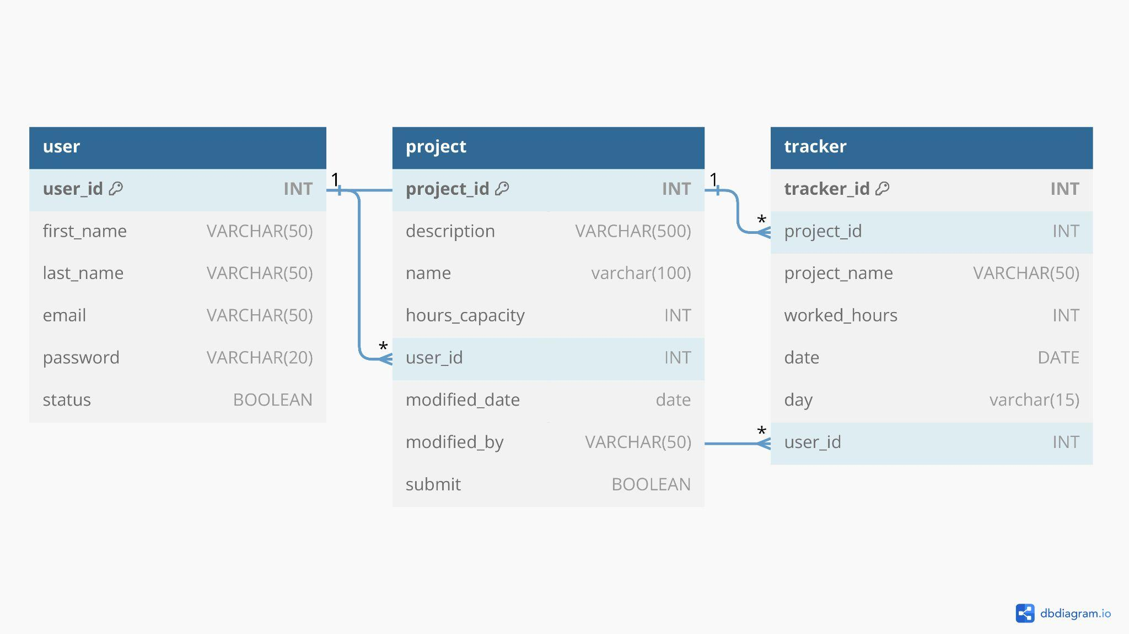
Data Mode

Slide 3
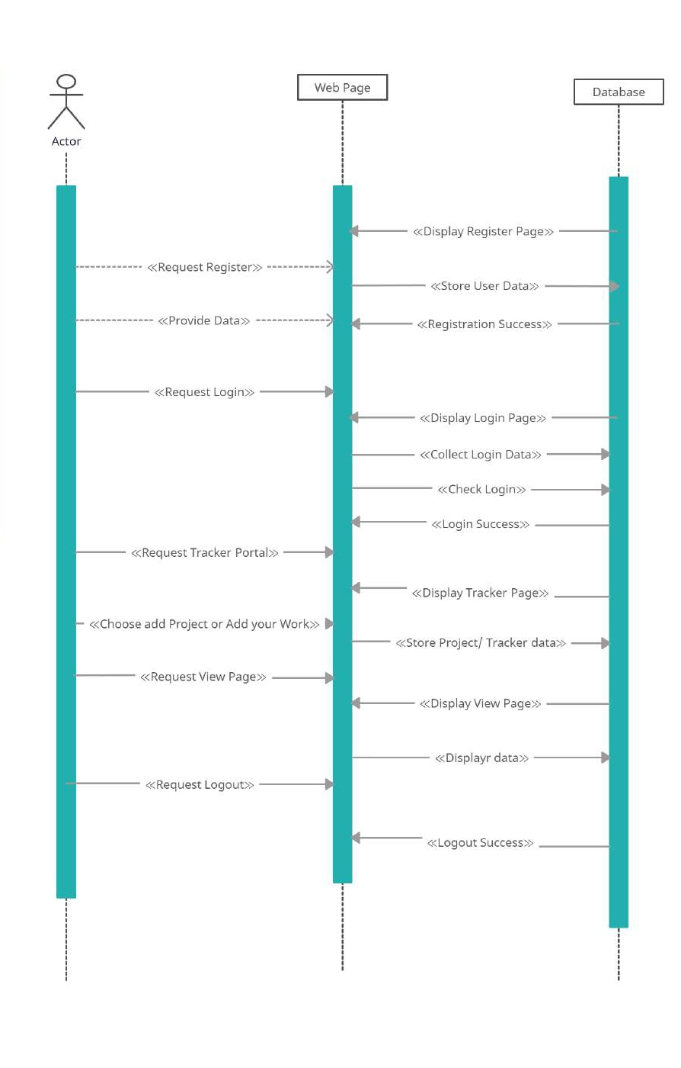
Sequence Diagram

Slide 4
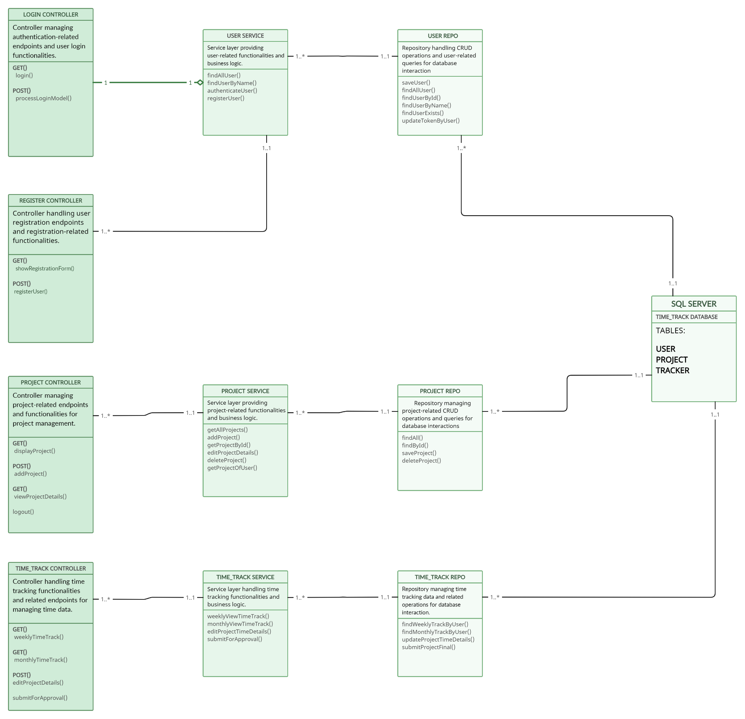
Class Diagram

Slide 5
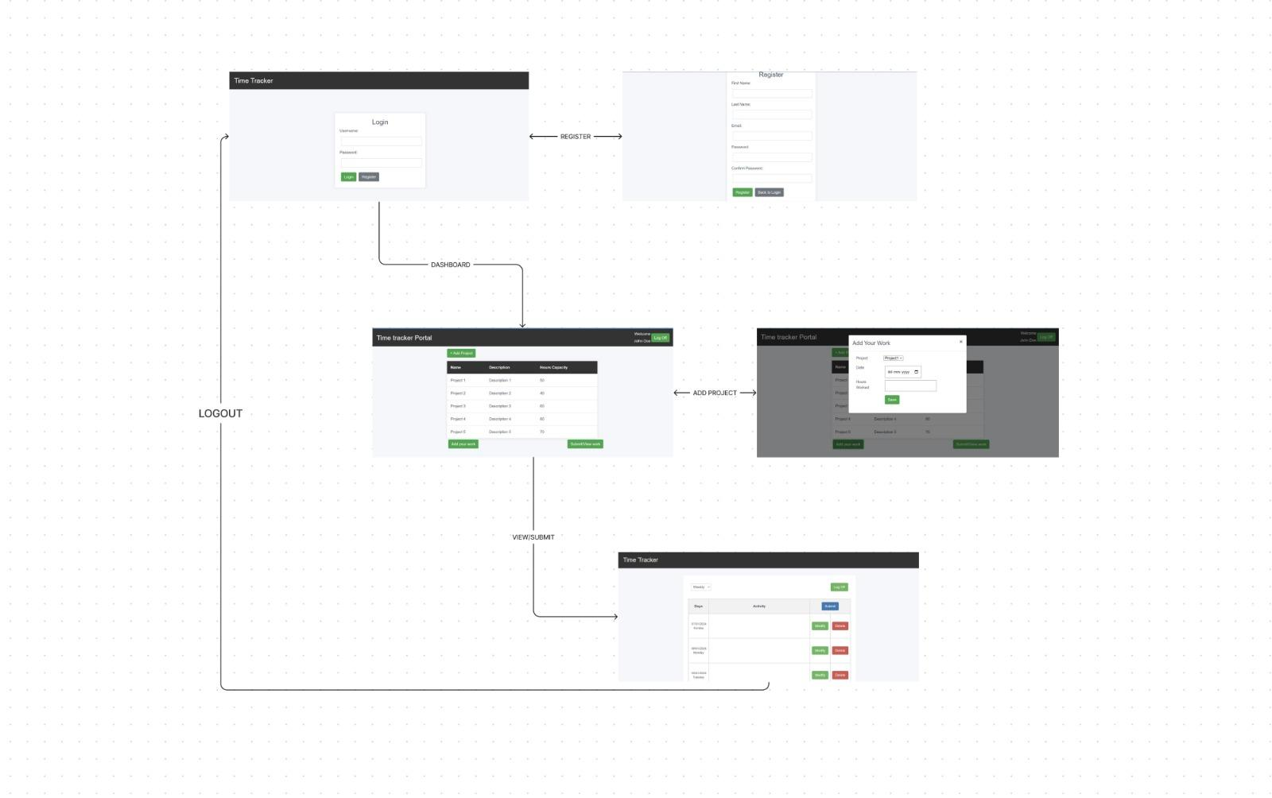
User Interface

Slide 6
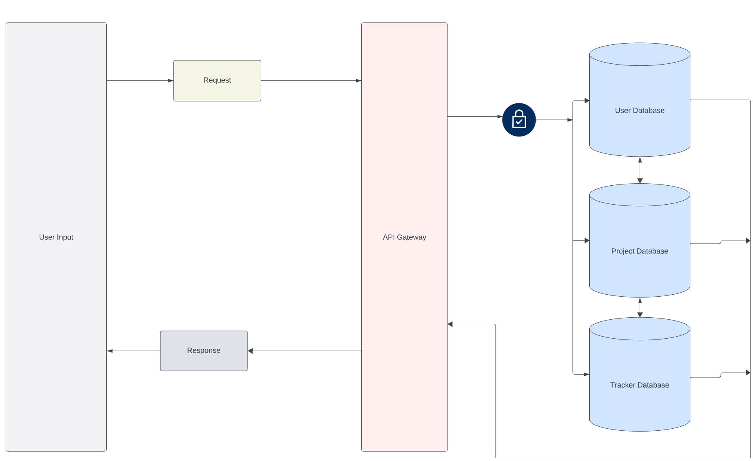
Application Architecture

